Slide 1
Learning shortest path tours to all pubs in UK
Sabeer Bakir
Student ID: 16333886
Supervisor: Dr. Deepak Ajwani

Slide 2
Introduction
Combinatorial optimization is an area of research that consists of finding an optimal ordering/subset from a finite set of objects.
Typically these problems are NP-Hard.
Researchers have worked for decades to find good solutions for these problems.
Can we learn the solutions to these optimization problems?

Slide 3
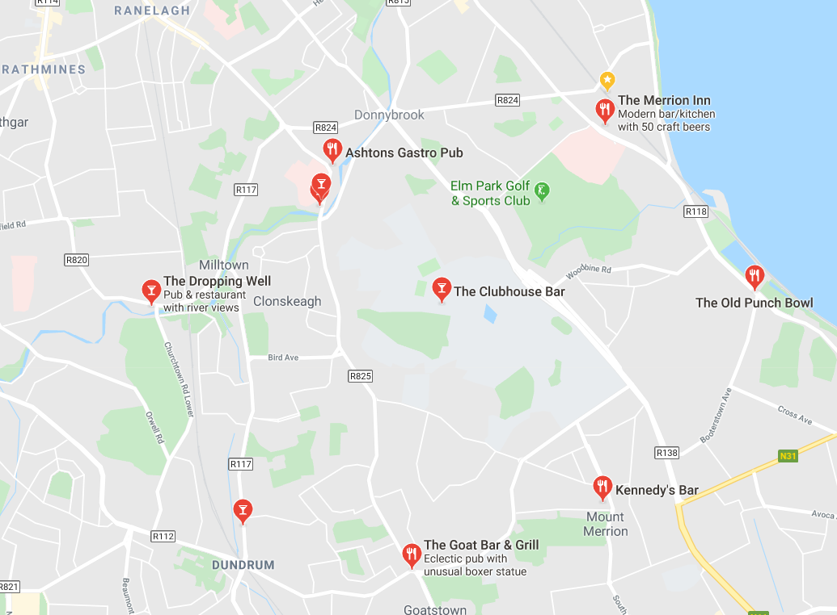
Travelling Salesman Problem
Given pairwise distances to each pub.
Travel to every pub once.
Return to the beginning.
Minimize the distance travelled.

Slide 4
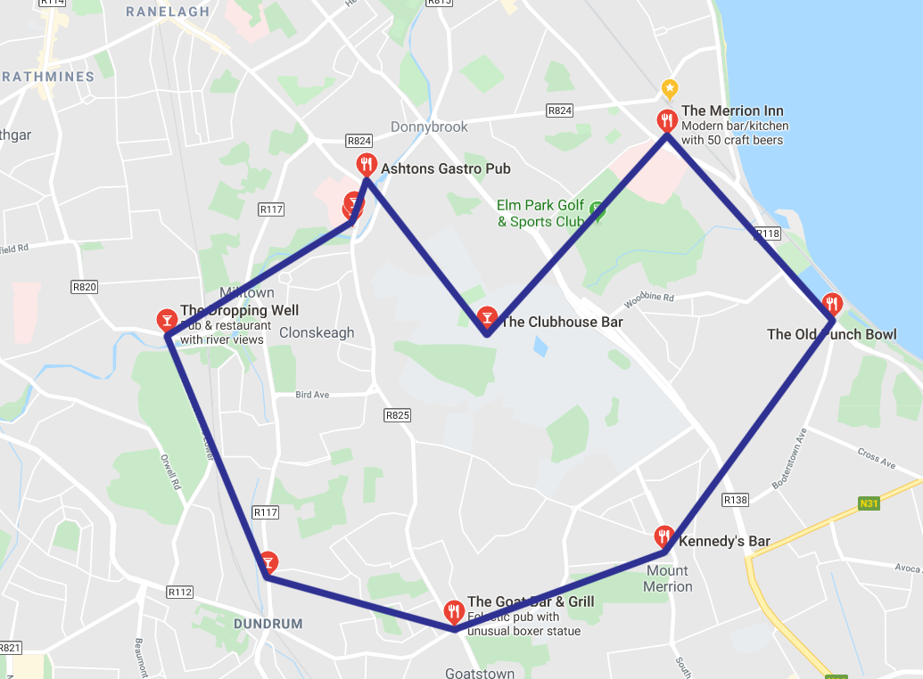
Travelling Salesman Problem

Slide 5
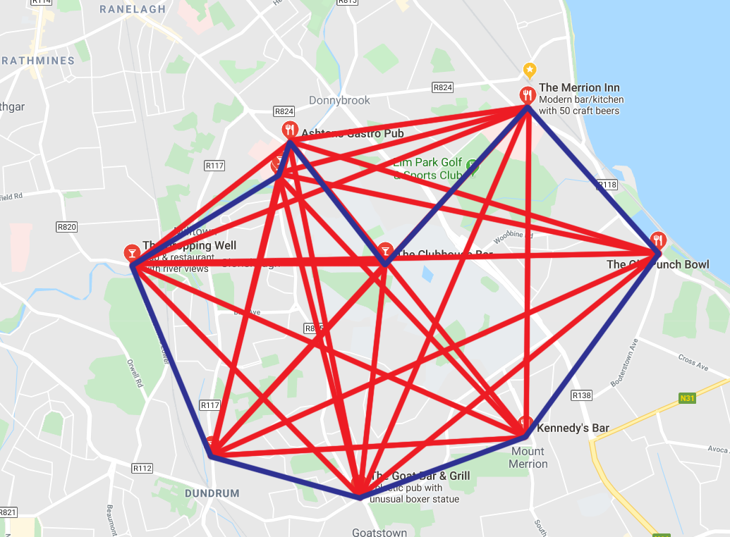
Travelling Salesman Problem

Slide 6
Related Work
There are many methods used to tackle the travelling salesman problem:
Exact Algorithms
Approximation algorithms
Heuristics
Meta-Heuristics
Learning Approaches:
Supervised/Unsupervised Machine learning
Reinforcement Learning

Slide 7
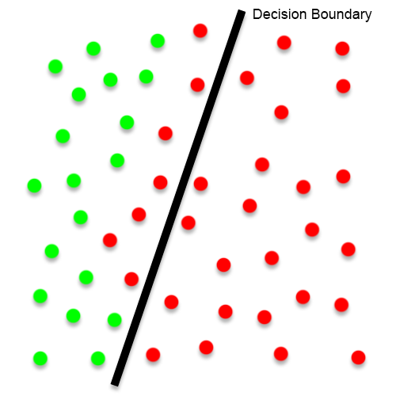
Outline of Approach
Using simple classifiers (rule-based, linear classifiers).
Build a binary classification model to learn if an edge is not a part of the travelling salesman tour.
This method allows the edge-list to be pruned.
Use exact/approximation algorithm on a smaller dataset.

Slide 8
Outline of Approach (contd.)
Features to describe an edge:
Ranking (wrt. both incident nodes)
Weight
Global edge ranking
Edge statistics
Early training will use Euclidean distance as the weight.
Ground Truth will be gathered using the Concorde TSP Solver.

Slide 9
Data Collection
Data scraped from https://www.pubsgalore.co.uk/.
Up-to-date list of pubs within the UK.
Contains attributes such as:
Name
Location coordinates
Address
70,000+ pubs on this website.

Slide 10
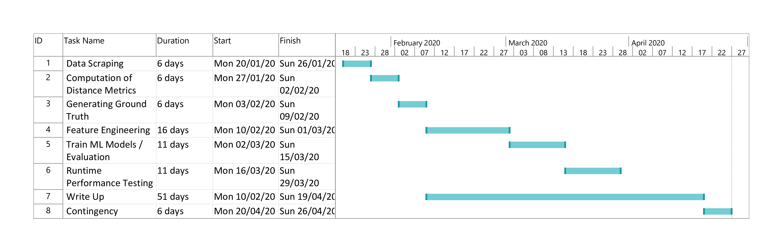
Timeline

